Slide 1
UNIT 3 LASER DIODES
Prepared By Dr.Christeena Joseph
Associate Professor
Department of ECE

Slide 2
Lasers come in many forms with dimensions ranging from the size of a grain of salt to one that will occupy an entire room.
The lasing medium can be a gas, a liquid, an insulating crystal (solid state), or a semiconductor.
For optical fiber systems the laser sources used almost exclusively are semiconductor laser diodes.
They are similar to other lasers, such as the conventional solid-state and gas lasers, in that the emitted radiation has spatial and temporal coherence; that is, the output radiation is highly monochromatic and the light beam is very directional.

Slide 3
Despite their differences, the basic principle of operation is the same for each type of laser.
Laser action is the result of three key processes:
photon absorption
spontaneous emission
stimulated emission

Slide 4
These three processes are represented by the simple two-energy-level diagrams in Fig where E1 is the ground-state energy and E2 is the excited-state energy.
According to Planck’s law, a transition between these two states involves the absorption or emission of a photon of energy hϒ₁₂ = E₂ – E₁. Normally, the system is in the ground state.
When a photon of energy hϒ₁₂ impinges on the system, an electron in state E1 can absorb the photon energy and be excited to state E2, as shown in Fig. a.
Since this is an unstable state, the electron will shortly return to the ground state, thereby emitting a photon of energy hϒ₁₂ .
This occurs without any external stimulation and is called spontaneous emission. These emissions are isotropic and of random phase, and thus appear as a narrowband gaussian output.

Slide 5
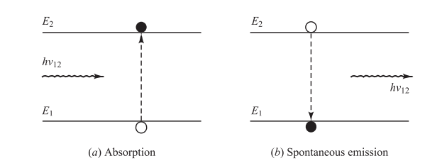

Slide 6
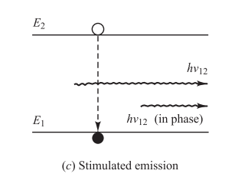
Electron can also be induced to make a downward transition from the excited level to the ground state level by an external stimulation
As shown in Fig. c, if a photon of energy hϒ₁₂ impinges on the system while the electron is still in its excited state, the electron is immediately stimulated to drop to the ground state and give off a photon of energy hϒ₁₂
This emitted photon is in phase with the incident photon, and the resultant emission is known as stimulated emission.

Slide 7
In thermal equilibrium the density of excited electrons is very small.
Most photons incident on the system will therefore be absorbed, so that stimulated emission is essentially negligible.
Stimulated emission will exceed absorption only if the population of the excited states is greater than that of the ground state.
This condition is known as population inversion.
Since this is not an equilibrium condition, population inversion is achieved by various “pumping” techniques.
In a semiconductor laser, population inversion is accomplished by injecting electrons into the material at the device contacts or through an optical absorption method by means of externally injected photons

Slide 8
Laser Diode Modes and Threshold Conditions
For optical fiber communication systems requiring bandwidths greater than approximately 200 MHz, the semiconductor injection laser diode is preferred over the LED.
Laser diodes typically have response times less than 1 ns, can have spectral widths of 2 nm or less, and are capable of coupling from tens to hundreds of milliwatts of useful luminescent power into optical fibers with small cores and small modefield diameters.
Virtually all laser diodes in use are multilayered heterojunction devices.
The more rapid evolvement and utilization of LEDs as compared with laser diodes lies in the inherently simpler construction, the smaller temperature dependence of the emitted optical power, and the absence of catastrophic degradation in LEDs .
The construction of laser diodes is more complicated, mainly because of the additional requirement of current confinement in a small lasing cavity.

Slide 9
Stimulated emission in semiconductor lasers arises from optical transitions between distributions of energy states in the valence and conduction bands.
This differs from gas and solid-state lasers, in which radiative transitions occur between discrete isolated atomic or molecular levels.
The radiation in one type of laser diode configuration is generated within a Fabry-Perot resonator cavity shown in Fig
Here the cavity is approximately 250–500 mm long, 5–15 mm wide, and 0.1–0.2 mm thick.
These dimensions commonly are referred to as the longitudinal, lateral, and transverse dimensions of the cavity, respectively

Slide 10
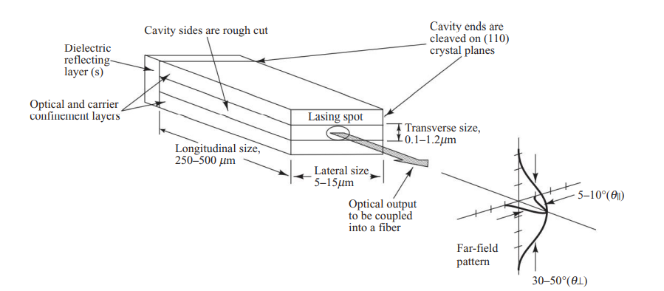
Fabry-Perot resonator cavity for a laser diode.

Slide 11
The cleaved crystal ends function as partially reflecting mirrors.
The unused end (the rear facet) can be coated with a dielectric reflector to reduce optical loss in the cavity.
Note that the light beam emerging from the laser forms a vertical ellipse, even though the lasing spot at the active-area facet is a horizontal ellipse.

Slide 12
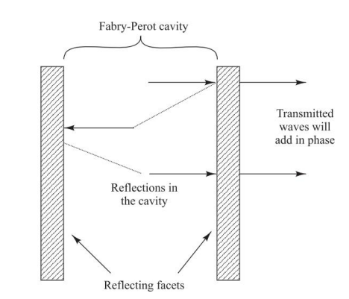
As illustrated in Fig. two flat, partially reflecting mirrors are directed toward each other to enclose the Fabry-Perot resonator cavity.

Slide 13
The mirror facets are constructed by making two parallel clefts along natural cleavage planes of the semiconductor crystal.
The purpose of the mirrors is to establish a strong optical feedback in the longitudinal direction.
This feedback mechanism converts the device into an oscillator (and hence a light emitter) with a gain mechanism that compensates for optical losses in the cavity at certain resonant optical frequencies.
The sides of the cavity are simply formed by roughing the edges of the device to reduce unwanted emissions in the lateral directions.

Slide 14
As the light reflects back and forth within the Fabry-Perot cavity, the electric fields of the light interfere on successive round trips.
Those wavelengths that are integer multiples of the cavity length interfere constructively so that their amplitudes add when they exit the device through the righthand facet.
All other wavelengths interfere destructively and thus cancel themselves out. The optical frequencies at which constructive interference occurs are the resonant frequencies of the cavity.
Consequently, spontaneously emitted photons that have wavelengths at these resonant frequencies reinforce themselves after multiple trips through the cavity so that their optical field becomes very strong.
The resonant wavelengths are called the longitudinal modes of the cavity because they resonate along the length of the cavity.

Slide 15
In another laser diode type, commonly referred to as the distributed-feedback (DFB) laser the cleaved facets are not required for optical feedback.
A typical DFB laser configuration is shown in Fig.
The fabrication of this device is similar to the Fabry-Perot types, except that the lasing action is obtained from Bragg reflectors (gratings) or periodic variations of the refractive index (called distributed feedback corrugations), which are incorporated into the multilayer structure along the length of the diode

Slide 16
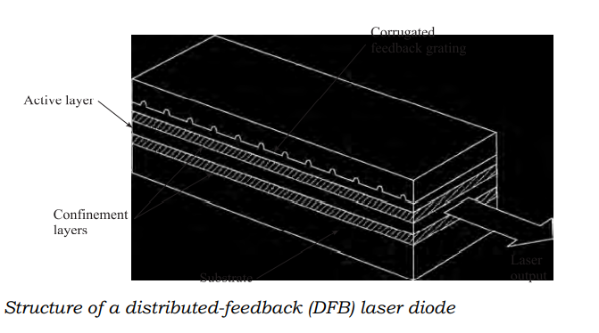

Slide 17
In general, the full optical output is needed only from the front facet of the laser—that is, the one to be aligned with an optical fiber.
In this case, a dielectric reflector can be deposited on the rear laser facet to reduce the optical loss in the cavity, to reduce the threshold current density the point at which lasing and to increase the external quantum efficiency.
Reflectivities greater than 98 percent have been achieved with a six-layer reflector

Slide 18
The optical radiation within the resonance cavity of a laser diode sets up a pattern of electric and magnetic field lines called the modes of the cavity .
These can conveniently be separated into two independent sets of transverse electric (TE) and transverse magnetic (TM) modes.
Each set of modes can be described in terms of the longitudinal, lateral, and transverse half-sinusoidal variations of the electromagnetic fi elds along the major axes of the cavity.
The longitudinal modes are related to the length L of the cavity and determine the principal structure of the frequency spectrum of the emitted optical radiation.
Since L is much larger than the lasing wavelength of approximately 1 mm, many longitudinal modes can exist. Lateral modes lie in the plane of the pn junction.
These modes depend on the side wall preparation and the width of the cavity, and determine the shape of the lateral profile of the laser beam.
Transverse modes are associated with the electromagnetic field and beam profile in the direction perpendicular to the plane of the pn junction.
These modes are of great importance as they largely determine such laser characteristics as the radiation pattern (the transverse angular distribution of the optical output power) and the threshold current density.

Slide 19
To determine the lasing conditions and the resonant frequencies, we express the electromagnetic wave propagating in the longitudinal direction (along the axis normal to the mirrors) in terms of the electric field phasor.
where I(z) is the optical field intensity, ω is the optical radian frequency, and β is the propagation constant

Slide 20

Lasing is the condition at which light amplification becomes possible in the laser diode.
The requirement for lasing is that a population inversion be achieved.
The stimulated emission rate into a given mode is proportional to the intensity of the radiation in that mode.
The radiation intensity at a photon energy hϒ varies exponentially with the distance z that it traverses along the lasing cavity according to the relationship
where is the effective absorption coefficient of the material in the optical path and Γ is the optical-field confinement factor—that is, the fraction of optical power in the active layer.

Slide 21

Optical amplification of selected modes is provided by the feedback mechanism of the optical cavity.
In the repeated passes between the two partially reflecting parallel mirrors, a portion of the radiation associated with those modes that have the highest optical gain coefficient is retained and further amplified during each trip through the cavity.
Lasing occurs when the gain of one or several guided modes is sufficient to exceed the optical loss during one roundtrip through the cavity; that is, z = 2L.
During this roundtrip, only the fractions R₁ and R₂ of the optical radiation are reflected from the two laser ends 1 and 2, respectively, where R₁ and R₂ are the mirror reflectivities or Fresnel reflection coefficients, which are given by

Slide 22
for the reflection of light at an interface between two materials having refractive indices n₁ and n₂
From this lasing condition equation becomes
For an uncoated cleaved facet the reflectivity is only about 30 percent.
To reduce the loss in the cavity and to make the optical feedback stronger, the facets typically are coated with a dielectric material.
This can produce a reflectivity of about 99 percent for the rear facet and 90 percent for the front facet through which the lasing light emerges.
At the lasing threshold, a steady-state oscillation takes place, and the magnitude and phase of the returned wave must be equal to those of the original wave. This gives the conditions

Slide 23
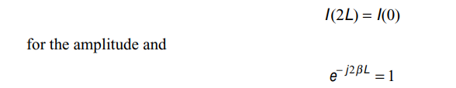

<-----------for the phase.
The condition to just reach the lasing threshold is the point at which the optical gain is equal to the total loss α_{t}, in the cavity and this condition is
where α_{end} is the mirror loss in the lasing cavity. Thus, for lasing to occur, we must have the gain g ≥ g_{th}. This means that the pumping source that maintains the population inversion must be sufficiently strong to support or exceed all the energy-consuming mechanisms within the lasing cavity

Slide 24
The mode that satisfies the above equation reaches threshold first. Theoretically, at the onset of this condition, all additional energy introduced into the laser should augment the growth of this particular mode.
In practice, various phenomena lead to the excitation of more than one mode.

Slide 25
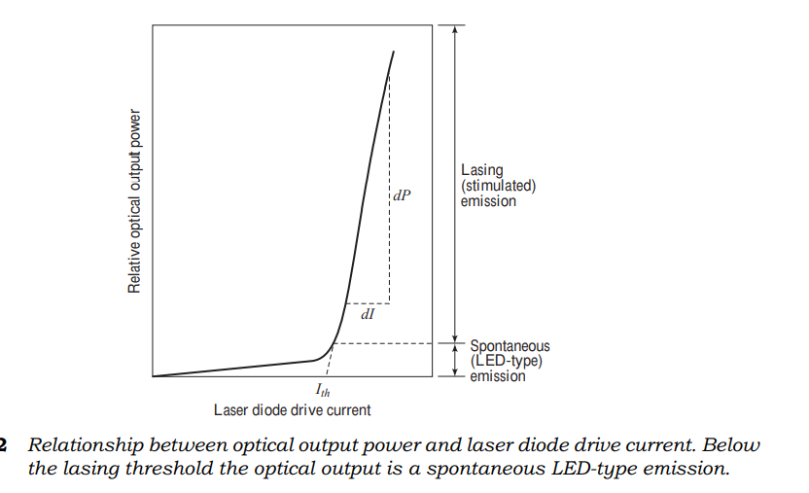
The relationship between optical output power and diode drive current is presented in Fig

Slide 26
At low diode currents, only spontaneous radiation is emitted. Both the spectral range and the lateral beam width of this emission are broad like that of an LED.
A dramatic and sharply defined increase in the power output occurs at the lasing threshold.
As this transition point is approached, the spectral range and the beam width both narrow with increasing drive current.
The final spectral width of approximately 1 nm and the fully narrowed lateral beam width of nominally 5–10° are reached just past the threshold point.
The threshold current I_{th} is conventionally defined by extrapolation of the lasing region of the power-versus-current curve, as shown in Fig..
At high power outputs, the slope of the curve decreases because of junction heating.

Slide 27

For laser structures that have strong carrier confinement, the threshold current density for stimulated emission J_{th} can to a good approximation be related to the lasing-threshold optical gain by

